Slide 1



A glimpse into the
Digital Analytics
The information contained in the document is proprietary to Tata Industries Limited- Tata Insights & Quants Division and is strictly confidential. In consideration of receipt of this document, the recipient agrees that the information is being shared only for the limited purpose. The recipient of this information further agrees to maintain such information in confidence and to not reproduce, disclose, duplicate, electronically transmit or use in whole or in part for any other purpose. Prior written consent shall be obtained from the Insights & Quants Division of Tata Industries in case the information is necessitated to be shared with anyone other than the Recipient to whom this information is addressed. The above restriction shall not limit the right to use the information contained in this deck, if it is obtained from another source without restriction.
© Copyright, Tata Insights & Quants Division, Tata Industries Limited

Slide 2
1. Web Analytics
Current Clients : Tata AIA, Tata Capital
Immediate Future Clients : Tata AIG , Tata CLiQ, Tata Power, GEC
Full time resources : Rahul, Fehrzard (Sales)
Shared resources : Kritika
Projects WIP | Projects Delivered | Success | Challenges
Adobe Analytics implementation support, reporting and advanced web analytics for Tata AIA – Duration : 1 year Google Analytics Setup and lead funnel analysis for Tata Capital – Duration : 1 month | Preliminary web analytics for Tata AIA using Google Analytics ‘CatchUp’ Campaign Analysis for Tata AIA | Entered long term contract with Tata AIA based on timely delivery of initial projects | 1 or 2 more full time resources would be required Training content on Adobe tools – Adobe Analytics , Test & Target

Slide 3
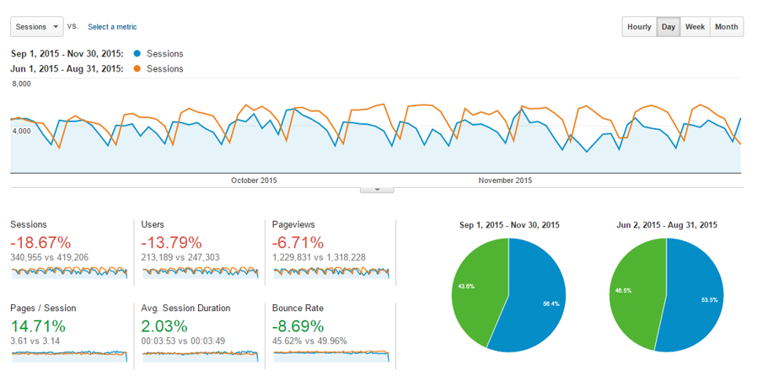
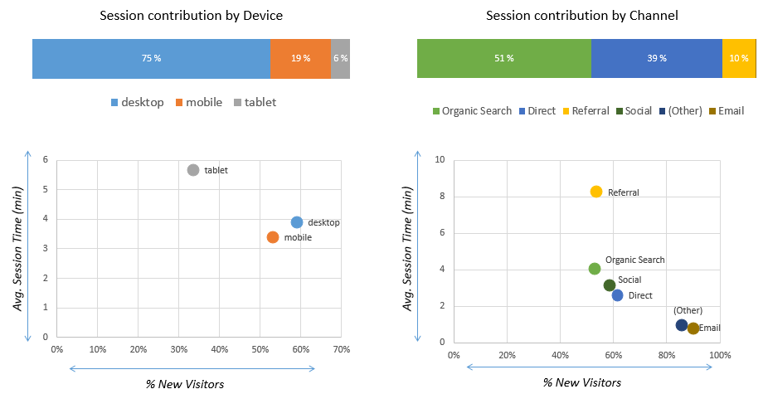
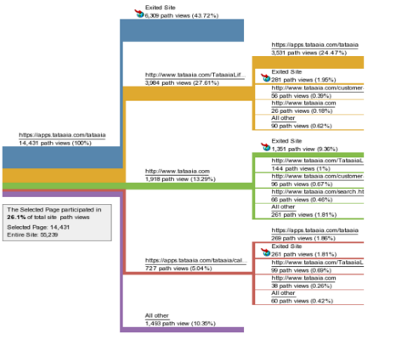
Website Performance
Objective:
The leading Financial Services provider wants to understand its website traffic & performance over time
Solution:
Based on Web Analytics tools such as Google Analytics and Adobe Analytics:
Website Traffic & Engagement Metrics
Audience Analysis
Top Sections & pages
Device and Channels
Result:
Client was able to understand increasing importance of its website for its business based on traffic data
Traffic Trend over time
Customer Journey
Confidential Property of Tata Industries Ltd – Tata Insights & Quants Division

Slide 4
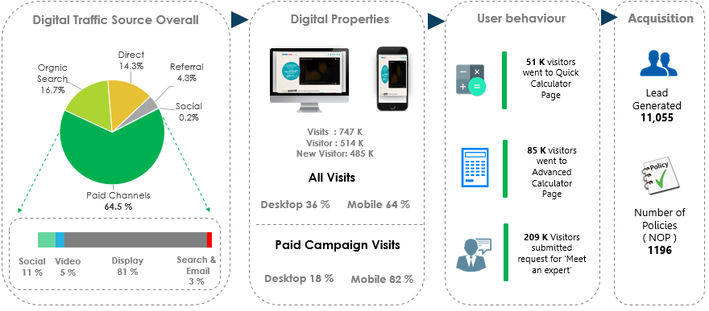
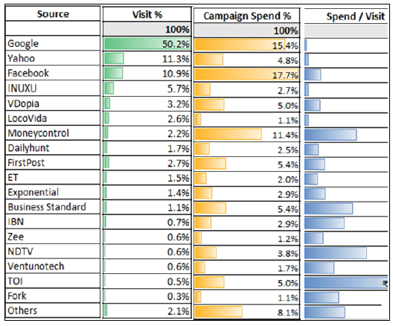
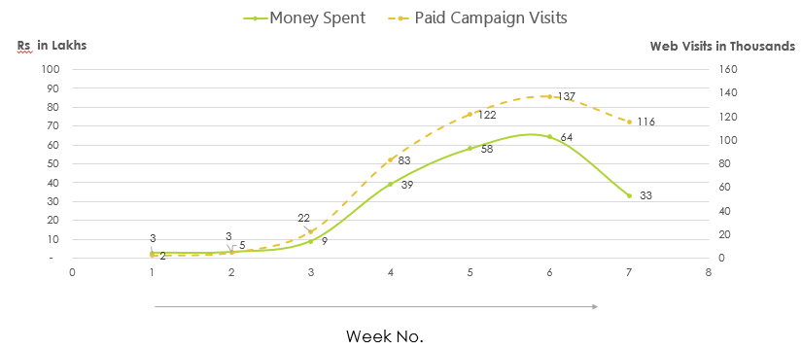
Digital Marketing Effectiveness
Confidential Property of Tata Industries Ltd – Tata Insights & Quants Division

Slide 5
2. Social Media Analytics
Current Clients : Tata AIA, Tata Capital
Immediate Future Clients : Tata Motors , Tata AIG
Full time resources : Rahul, Fehrzard (Sales)
Shared resources : Kritika
Projects WIP | Projects Delivered | Success | Challenges
Social Media Benchmarking Dashboard for Tata AIA – Duration : 1 year Social Media Lead Analysis for Tata Capital – Duration : 1 month Tata CLiQ social media performance – Duration : Ad-hoc | Monthly Social Media Dashboard for Tata AIA Social Media Metrics Benchmarking Sentiment Analysis Social Campaign Analysis Topic & Content Analysis Perceptual Map for Tata Tiago and its competitors | Entered long term contract with Tata AIA based on timely delivery of initial projects | Listening tool would be required to do topic analysis for clients across web/blogs Listening tool – Konnectsocial : Rs 18 Lakhs/ year To Build Social Media Data Products, Firehose access of social data is required (very expensive) Firehose tool – DataSift : Rs 1 Crore / year

Slide 6

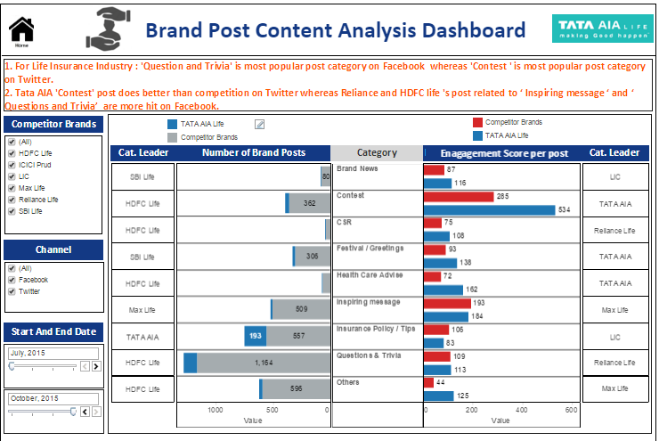
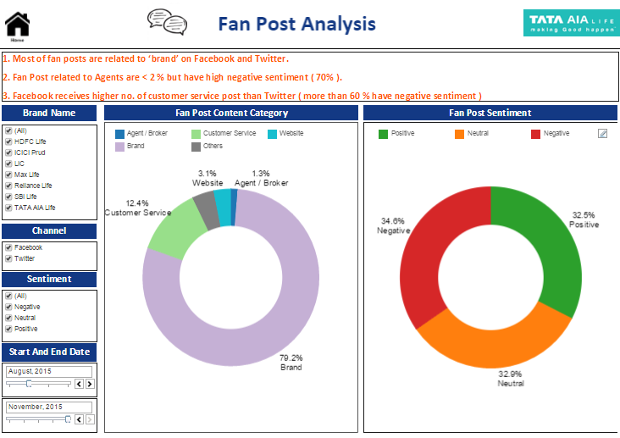

Analyse Topics & Themes
Objective:
For a leading Insurance provider –
To be more relevant in its Social Media Communication, hence increasing its Social Reach
Solution:
Monthly Tableau dashboard to highlight :
Analyse themes & topics relevant to life insurance which are most discussed on social media
Performance of competition brands on top identified themes
Result:
Highest Growth in Social Reach in competitive set for subsequent 2 months.
Life Insurance
Brand Content Analysis
Voice of Customer
Customer Topic Analysis
Confidential Property of Tata Industries Ltd – Tata Insights & Quants Division

Slide 7
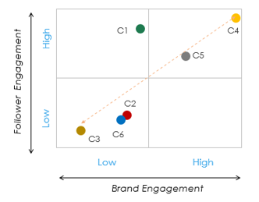
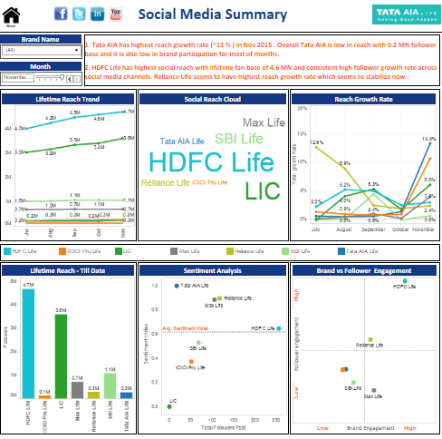
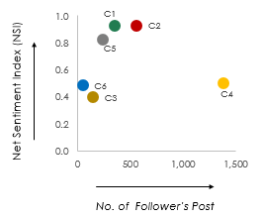
User Engagement & Sentiment Analysis
Objective:
For a leading Insurance provider –
To enhance user engagement on Social Media, and benchmark engagement against competition
Solution:
Monthly Tableau dashboard benchmarking :
Reach and Engagement metrics with respect to top competitors
Social Sentiment
Social Campaign performance
Result:
Benchmarked Response Time Vs. Competition – Resulted in halving the response time
Life Insurance
Social Engagement
Social Sentiment
Social Campaign Performance
Confidential Property of Tata Industries Ltd – Tata Insights & Quants Division

Slide 8
3. DigiSights
Current Clients : Tata AIA
Immediate Future Clients : Tata AIG, TULIP
Full time resources : Rahul, Fehrzard (Sales)
Shared resources : Kritika
Projects WIP | Projects Delivered | Success | Challenges
DigiSights for Tata AIA – Duration : 1 year DigiSights for Tata Sons covering major sectors – Duration : 1.5 month | DigiSights for Tata Sons across 16 business sectors |  | Need to purchase license for Tata AIA, Tata AIG & TULIP Cost of each additional license would be ~ 12.5 lakhs ( including taxes)

Slide 9
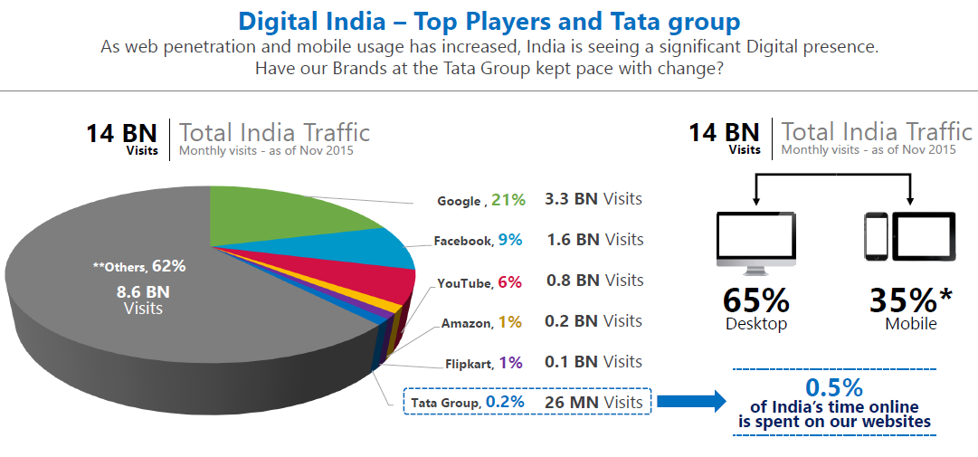
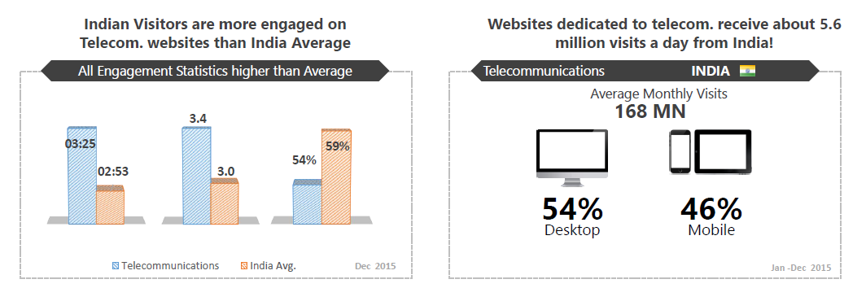
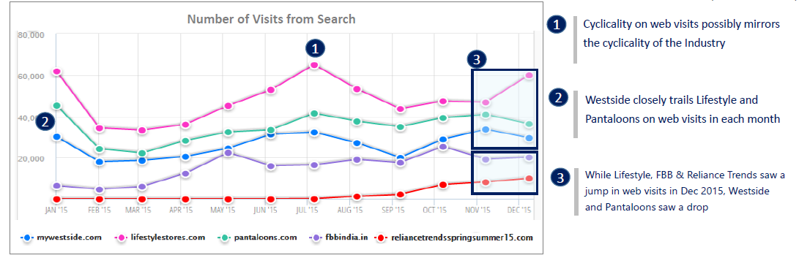
Digital Presence of Tata Group
Objective:
Showcase Power of Website Performance Benchmarking
Solution:
Website performance of 16 Tata brands were benchmarked with respect to their competitors in each industry, throwing sample insights into:
Traffic & Engagement
Traffic Source Comparison
Opportunities to increase Digital Presence
Tata Group Analysis
Industry Analysis
Direct Competitors
Confidential Property of Tata Industries Ltd – Tata Insights & Quants Division

Slide 10
4. Visualization
Current Clients : Tata AIA, Tata Capital, Croma , GEC
Immediate Future Clients : Tata AIG, Tata CliQ
Full time resources :
Shared resources : Kritika, Sanket
Projects WIP | Projects Delivered | Success | Challenges
Geo-Profiling for Tata Capital Business Loans Performance Dashboard for Tata Capital Monthly Social Media Dashboard for Tata AIA Chairman business performance dashboard for Tata Sons | Shop Share Smile Dashboard for Tata Sons Geo- Profiling based on affluence for Croma POC Dashboard representing order fulfilment journey for Tata CLiQ |  | Clients are more inclined towards individual purchase of Tableau License and building an in-house team

Slide 11

Contact Us
+91- 900 819 9115
digital@tataiq.com
dthomas@tata.com
Tata Industries Limited
Tata Insights & Quants Division
‘The Address’ | 5th Floor | Sy. No.17/1 | Outer Ring Road
Oppo. Prestige Cessna Park | Kadubeesanahalli| Bangalore 560 087

Slide 12
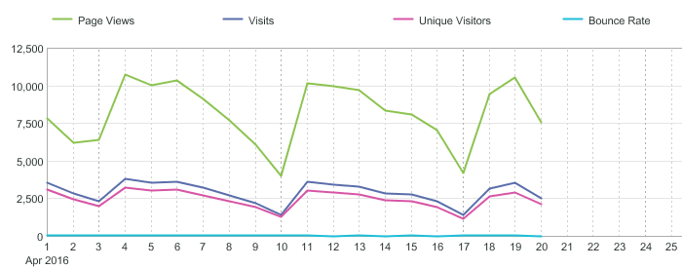
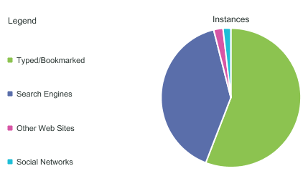
Web Analytics by Tata iQ : Leveraging Adobe Analytics
Standard Reports in Adobe
Customized Reports using Adobe
Basic Website Metrics
Example:
Web traffic trends segmented based on visitor segments , devices , geography and channels
Performance of website pages/section in terms of views and engagement over time
Traffic source performance mapping with respect to Campaign tracking code & business needs
Business Diagnosis
Example:
Opportunities to effectively increase quality traffic on website
Attribution analysis of traffic trends to market or internal events
Weak and strong aspects of website in terms of content and features
Traffic Source Reports
Confidential Property of Tata Industries Ltd – Tata Insights & Quants Division

Slide 13
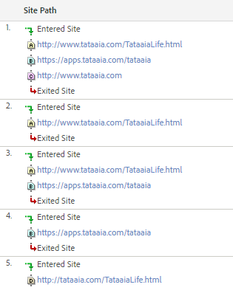
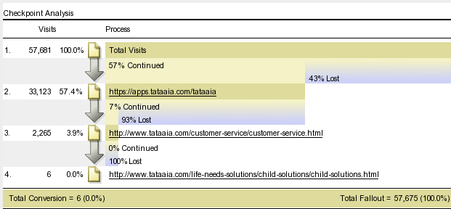
Web Analytics by Tata iQ : Leveraging Adobe Analytics
Standard Reports in Adobe
Customized Reports using Adobe
Example:
Top website Paths segmented based on visitor type, devices , geography and channels
Customized funnel performance to understand visitors’ behaviour over website
Path Report
Funnel Report
Business Diagnosis
Example:
Possible solutions to impediments faced by customer for micro-conversions on website – Lead Form / Customer service etc.
Suggestion on landing pages optimization & website structure for improved lead conversion and engagement on website
……….
Confidential Property of Tata Industries Ltd – Tata Insights & Quants Division

Slide 14
Digital Analytics: Website Performance
Input from Adobe Analytics
Analysis
Techniques
Output
Recommendations On
Markov Chain Model
Optimized Paths
Website Structure
Customized Report :
Clickstream Data– Visitor level
Fallout Report
Page Reports
Event Data
Visitor / Visit Clustering
Visitor Persona
Targeting for Marketing Campaigns
Multivariate Regression
Website Feature Analysis
Website Structure / UX
Feedback
Confidential Property of Tata Industries Ltd – Tata Insights & Quants Division

Slide 15
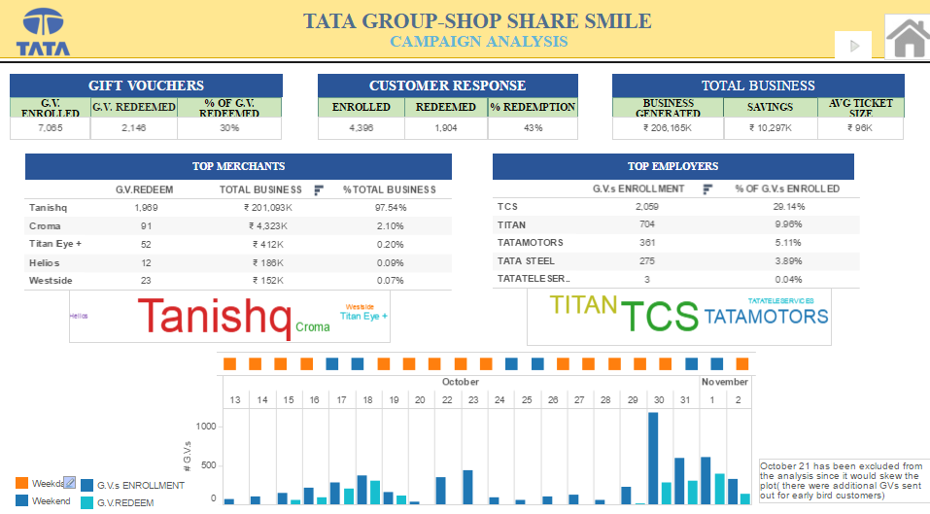
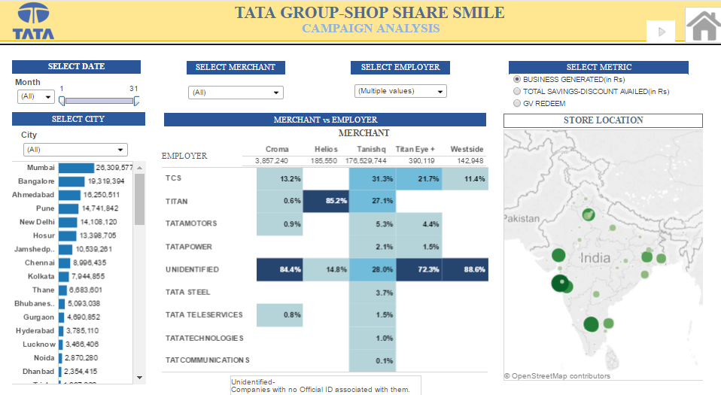
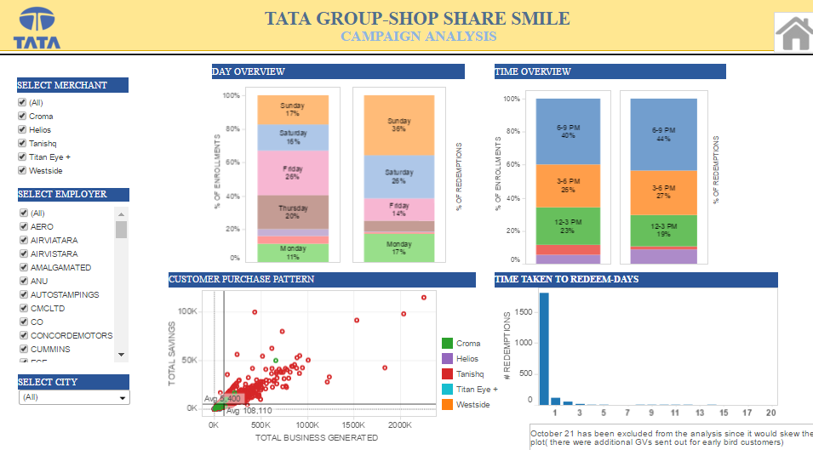
Tableau Case Study 1 : Campaign Performance – Group wide
Background
Methodology
Objective:
Tata Group wants to analyse the performance of ‘Shop Share & Smile’ Program.
Solution:
Tableau dashboard to highlight :
Key Business KPIs
Performance of Companies across geographies
Customer Purchase Pattern
Employee Redemptions
Result:
Effective campaign analysis providing insights for better targeting and personalization for next launch of program
Business KPI
Performance across Companies & Geography
Customer Purchase Pattern

Slide 16
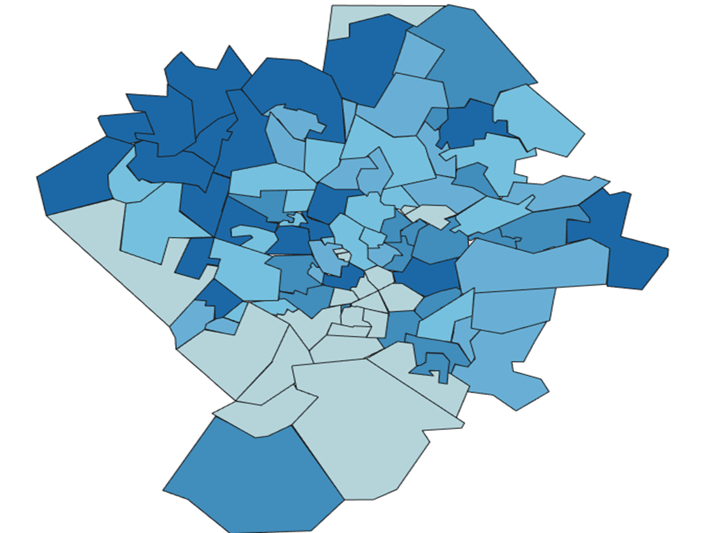

Tableau Case Study 2 : Electronics Retailer – Location Optimization
Background
Methodology
Store Location Attractiveness
Objective:
The retailer was looking to expand presence in the district of Hyderabad.
Solution:
Tableau visualization to highlight :
Catchment area attractiveness with respect to the retailer
Impact of Competitor presence
Potential Store locations with respect to catchment area attractiveness and competitor presence
Result :
The visualization and the solution helps understand
Relative attractiveness of planned store locations
Attractive locations as potential expansion opportunities
Potential of Catchment
Location Characteristics
Location Attractiveness model
Probability of Store Visit from Catchment
Store/Competitor Distance
Driving Distance to Store/Competitor PIN
Location map not to scale
Location map not to scale
Competitor 1
Competitor 2
Potential gradient – High to Low
Proposed Locations

Slide 17
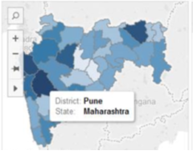
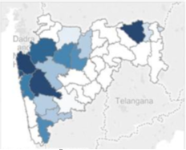
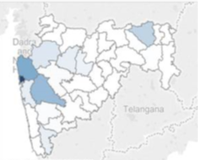
Tableau Case Study 3 : Financial Services - Business Loans Opportunities
Background
Methodology
Business Loan Opportunity
Objective:
The leading Financial Services provider has a selective but national presence with respect to Business Loans.
Solution:
Tableau visualization to highlight :
The most attractive locations for business loans
Market share in attractive and relatively less attractive locations
Sales presence vis a vis location attractiveness and market share
Result :
The visualization helps client to analyse :
Market share in high attractive locations
The locations with low market share which might be driven by low DSA presence
District Level Classification by Dimension
Business Loans Attractiveness
Market Share
DSA Presence

